Slide 1

Calibration, Validation, and Machine Learning for the NASA/JPL EMIT Mission Using a Network of Ground-based Robotic Measurements of Aerosols, Radiances, and Mission Spectral Cubes
Purvi Sehgal
California Institute of Technology
W.H. Halpenny SURF Fellow

Slide 2
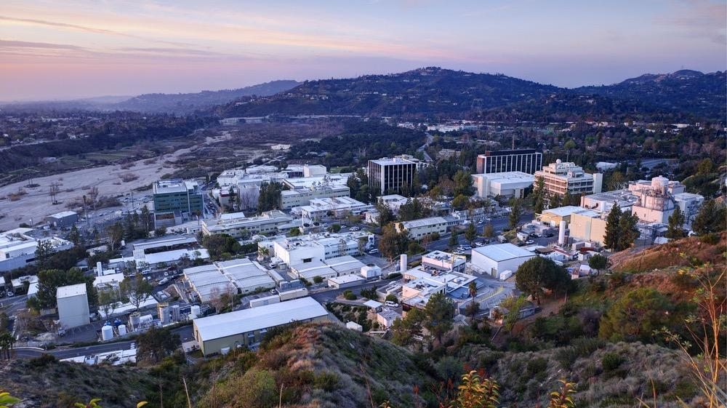

Special Thanks
Dr. David Thompson, Jet Propulsion Laboratory
For required markings, please visit https://mh.jpl.nasa.gov

Slide 3
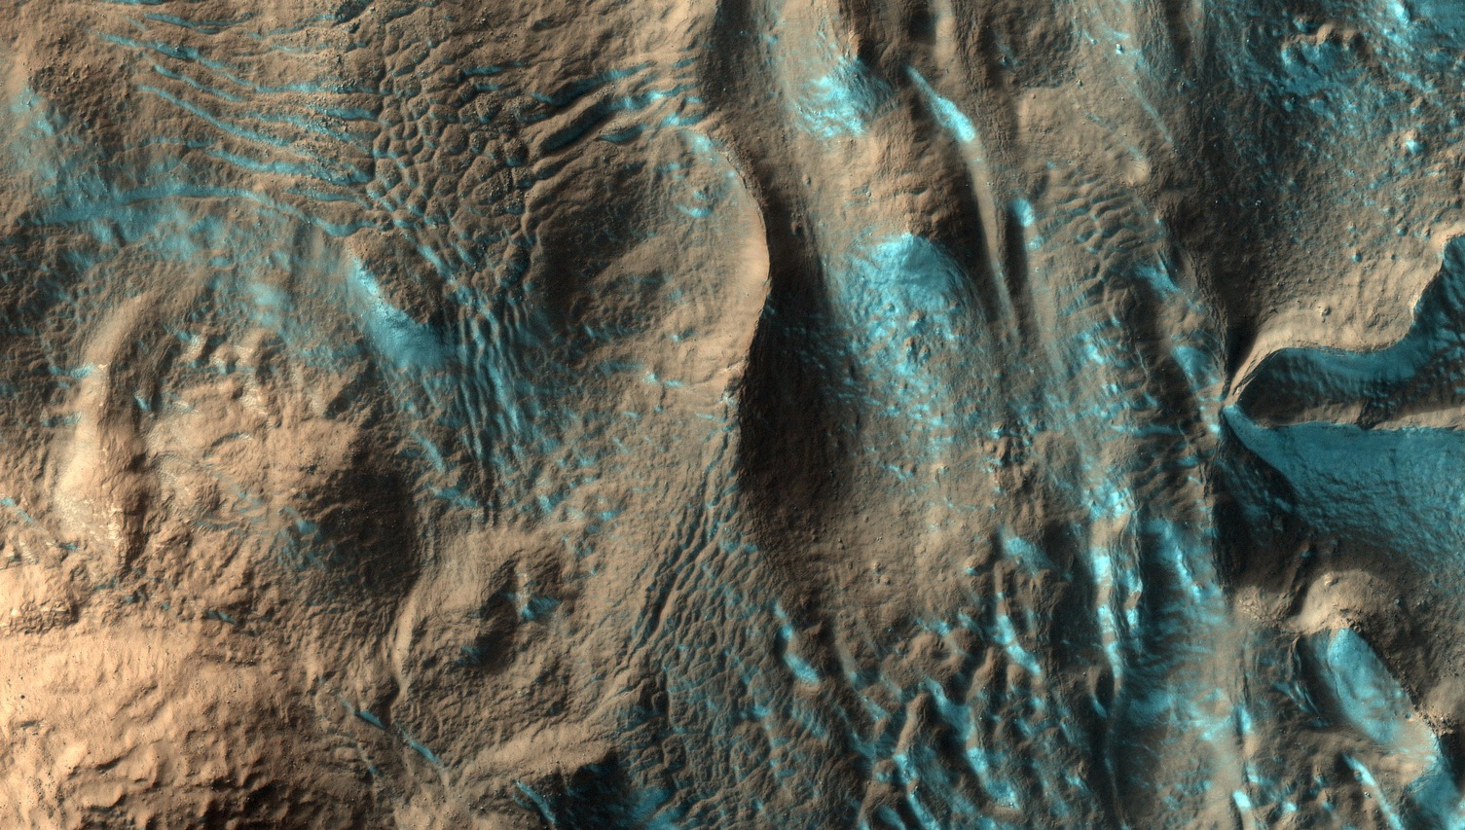
Introduction
For required markings, please visit https://mh.jpl.nasa.gov

Slide 4
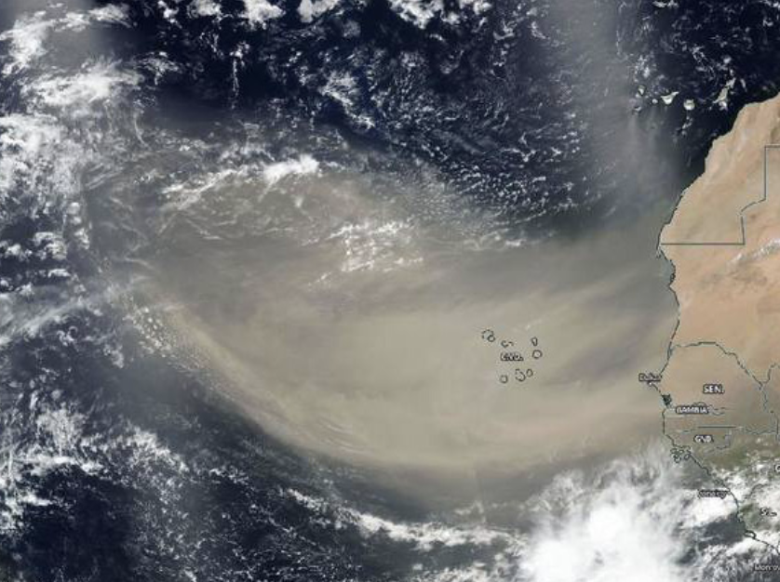
EMIT Mission
Key Words
Atmospheric Dust Clouds
Radiance

Slide 5
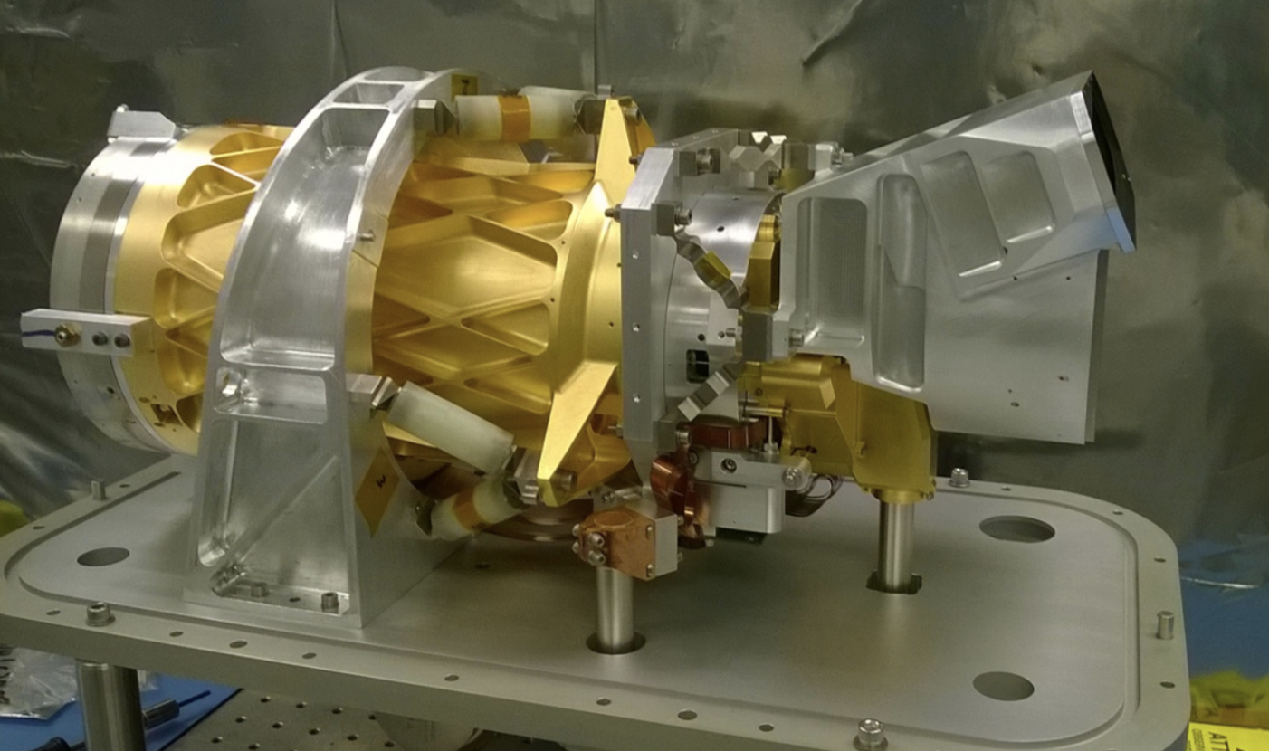
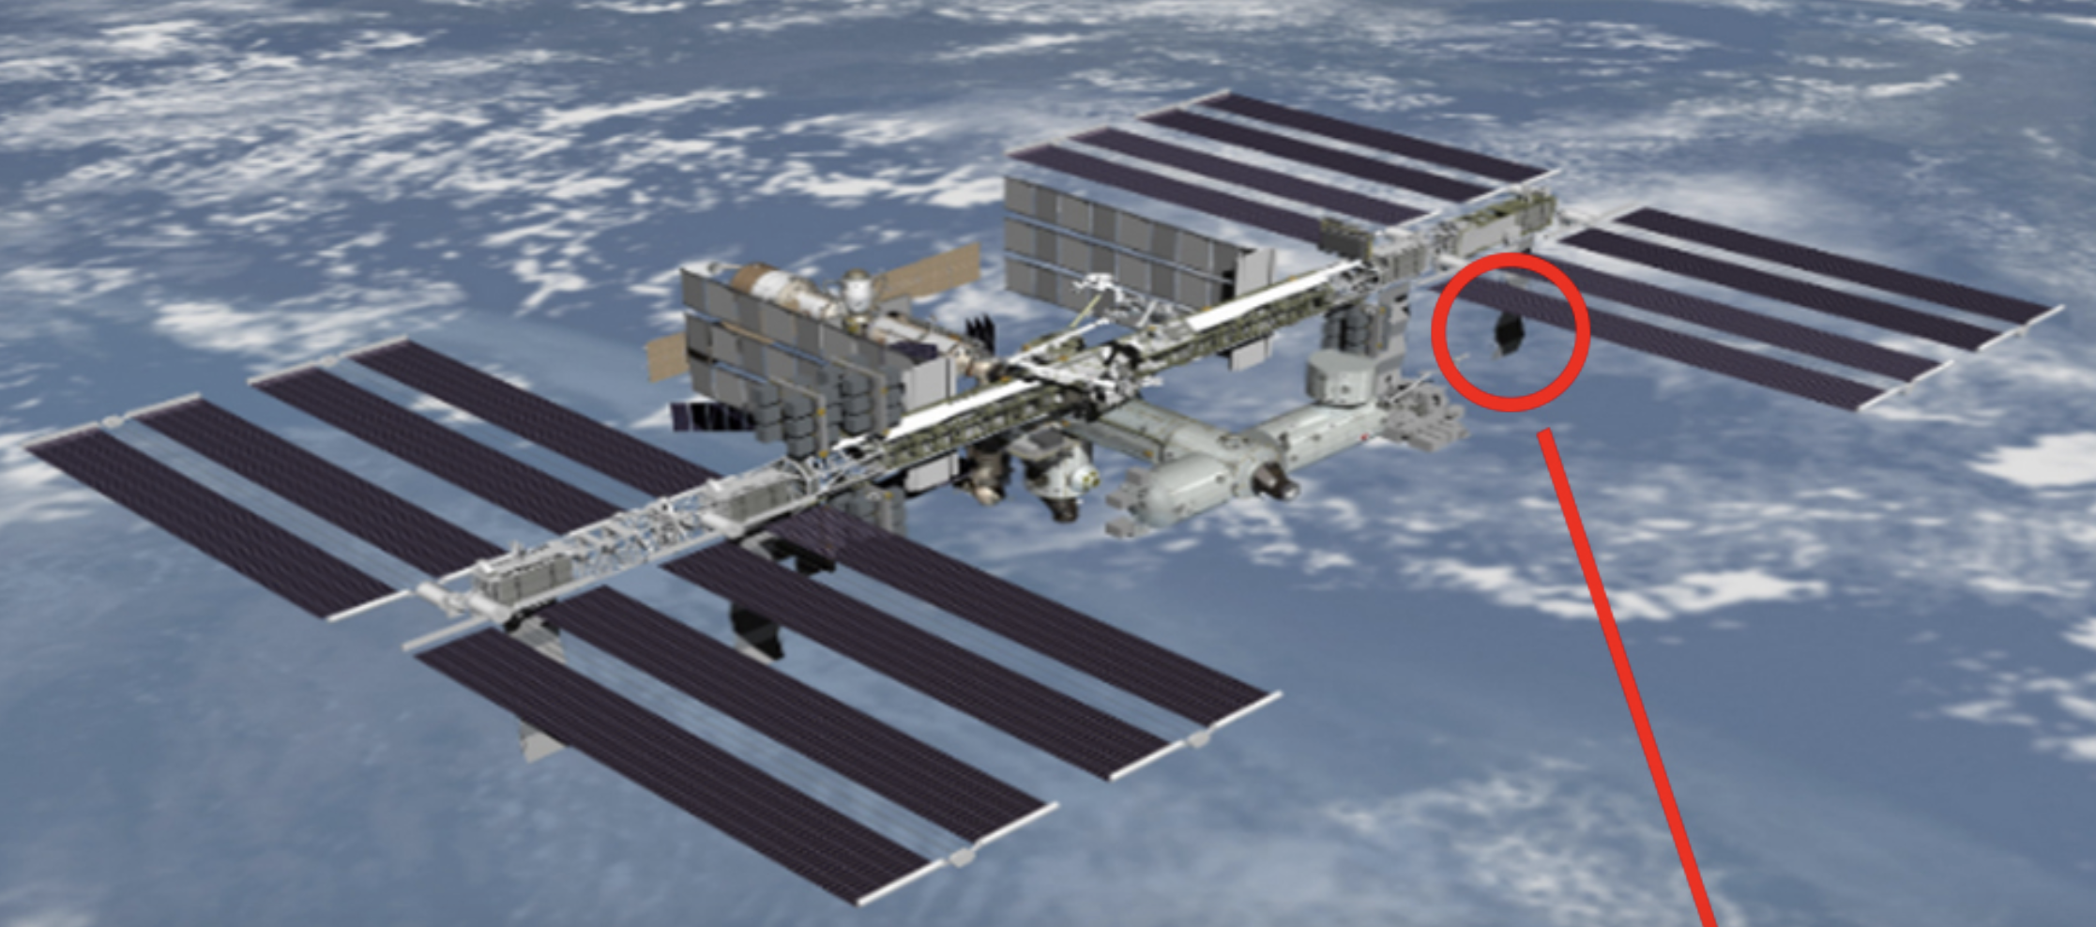
EMIT Mission
What is EMIT?

Slide 6
EMIT Mission
What is the Purpose of EMIT?
Earth
Surface
Mineral
Dust
Source
Investigation

Slide 7
EMIT Mission
How Does the Instrument Work?
Aerosol Optical Depth (AOD)
Surface Reflectance
Surface Mineralogy
Mineral Dust Composition
Radiance
Measured by EMIT
Goal
Notes:
Explain point of knowing aerosol optical depth accuracy

Slide 8
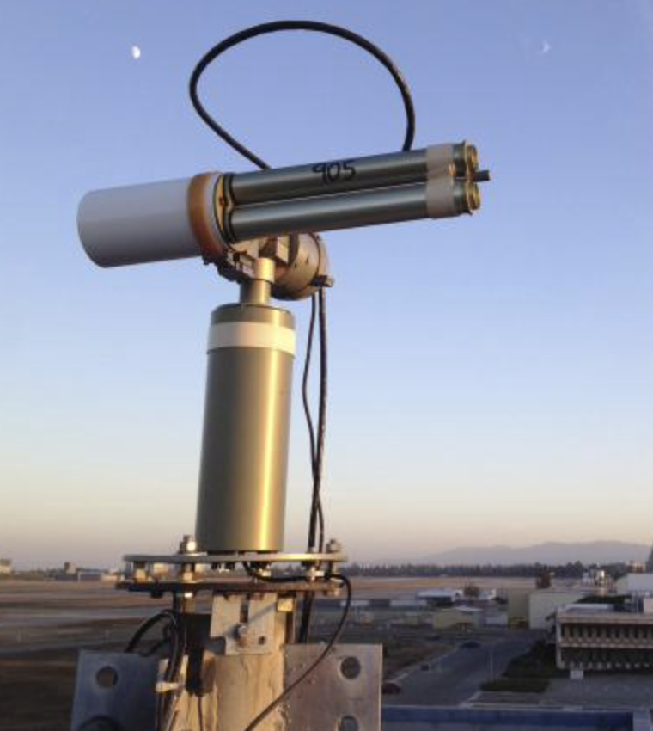
EMIT Mission
AERONET Sites
A series of ground-based remote sensing aerosol networks that send collected information to a single database
Notes:
Explain point of knowing aerosol optical depth accuracy

Slide 9
Task 1
For required markings, please visit https://mh.jpl.nasa.gov

Slide 10
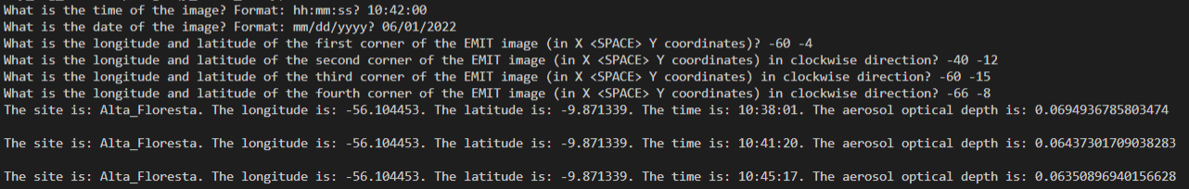
EMIT Mission
Task 1: Features of the Program
Inputs:
Notes:
Explain point of knowing aerosol optical depth accuracy

Slide 11
EMIT Mission
Task 1: Developing the Program
01
05
09
Downloaded AERONET Data Files as CSV
Developed Code to Retrieve AOD Values at Matching Sites
Debugged & Tested
02
Developed Code to Take Location and Time
Inputs
06
Fit and Interpolated Data to Determine Specific AOD
03
07
Developed Code to Return Matching AERONET Sites
Improved Efficiency and Generalized Code
04
08
Developed Code for Rotated Instead of Aligned Images
Modified Code for Special Cases
Notes:
Explain point of knowing aerosol optical depth accuracy

Slide 12
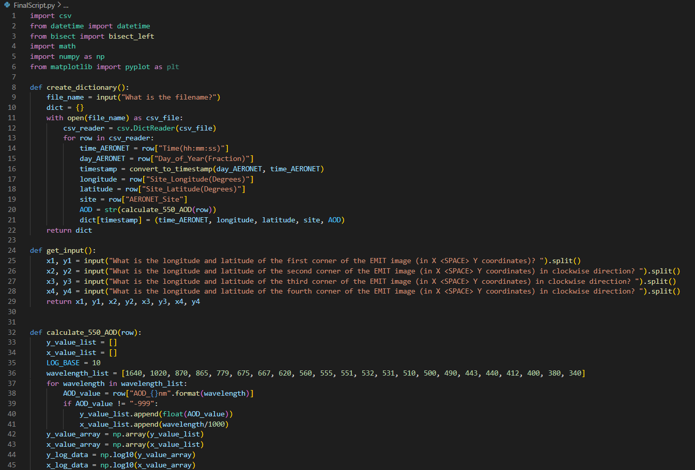
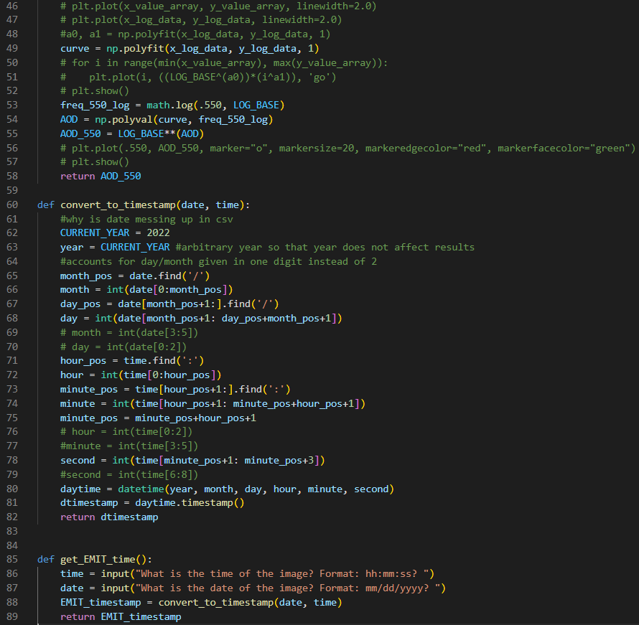
EMIT Mission
Task 1: Code
Notes:
Explain point of knowing aerosol optical depth accuracy

Slide 13
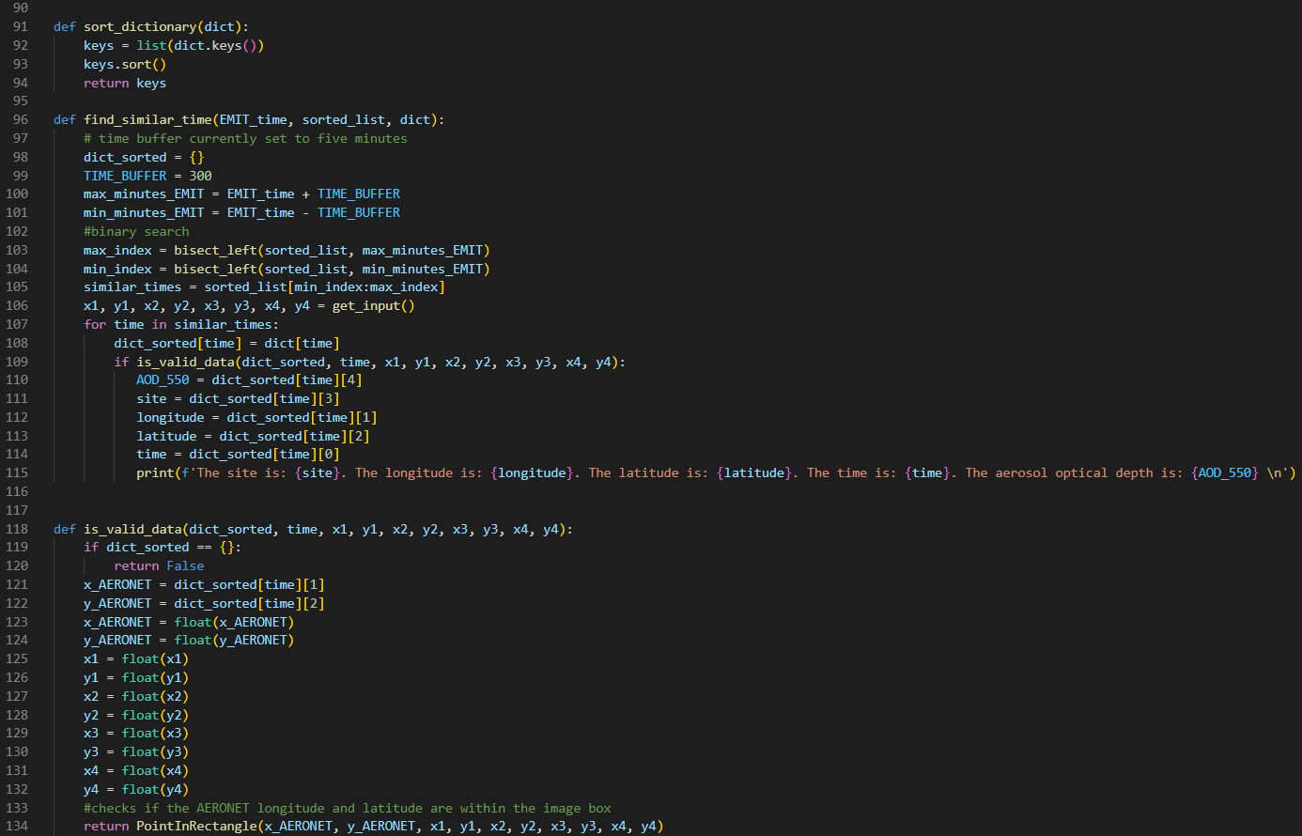
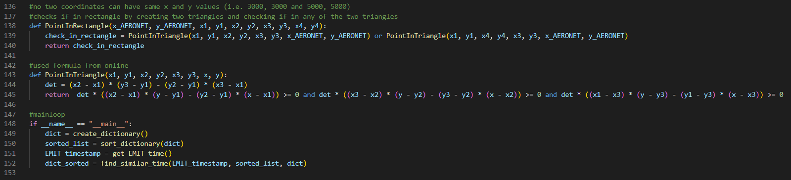
EMIT Mission
Task 1: Code Part 2
Notes:
Explain point of knowing aerosol optical depth accuracy

Slide 14
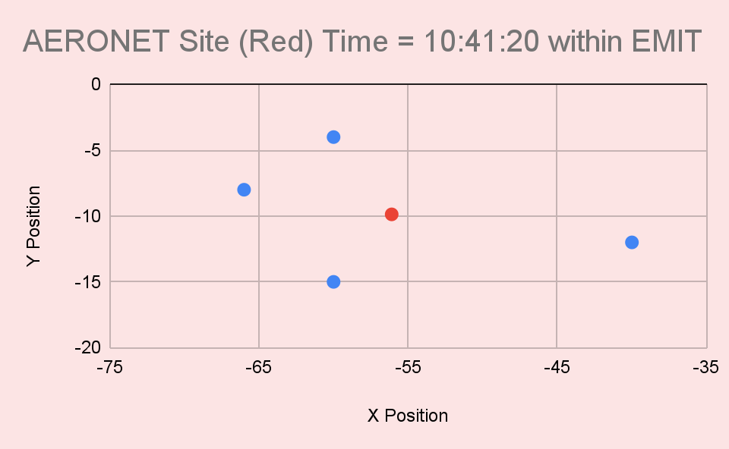
EMIT Mission
Task 1: Results
Notes:
Explain point of knowing aerosol optical depth accuracy

Slide 15
Task 2
For required markings, please visit https://mh.jpl.nasa.gov

Slide 16
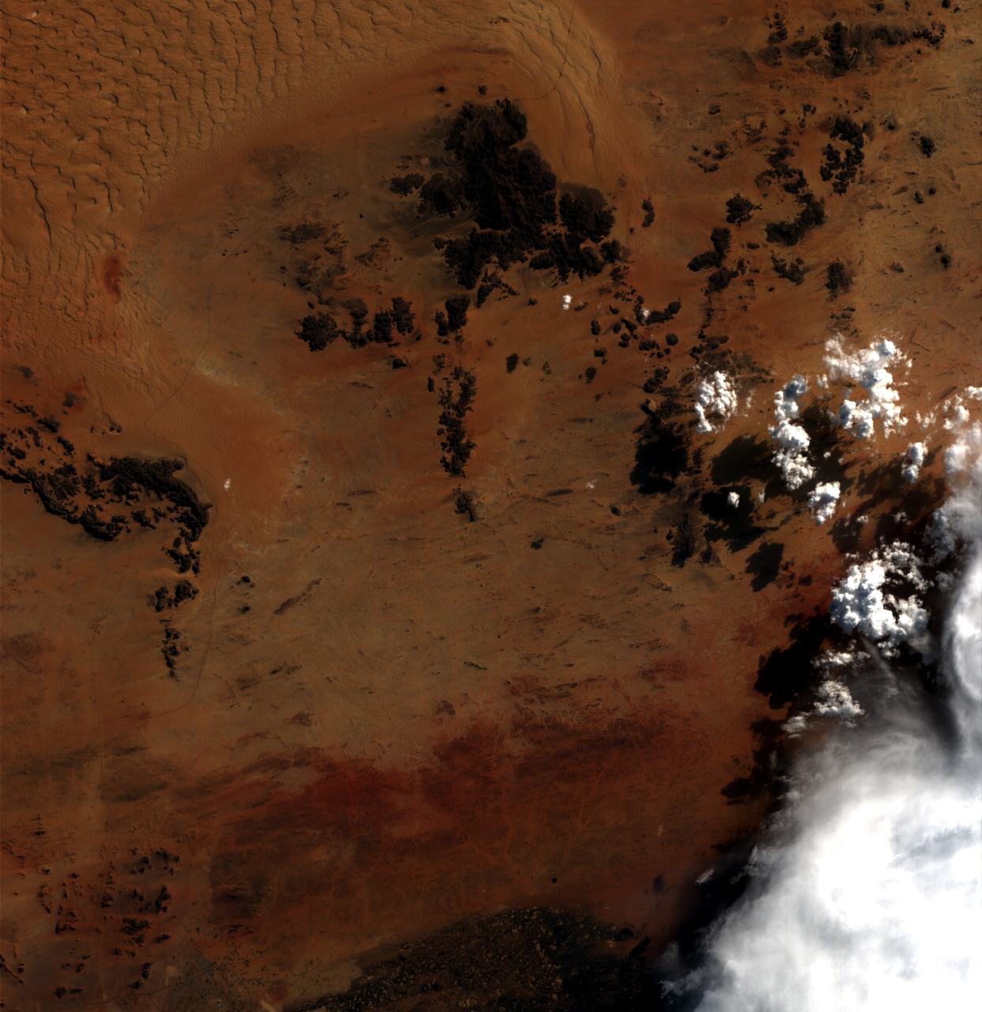
EMIT Mission
Task 2: Objective
Sample EMIT Image
Notes:
Explain point of knowing aerosol optical depth accuracy

Slide 17
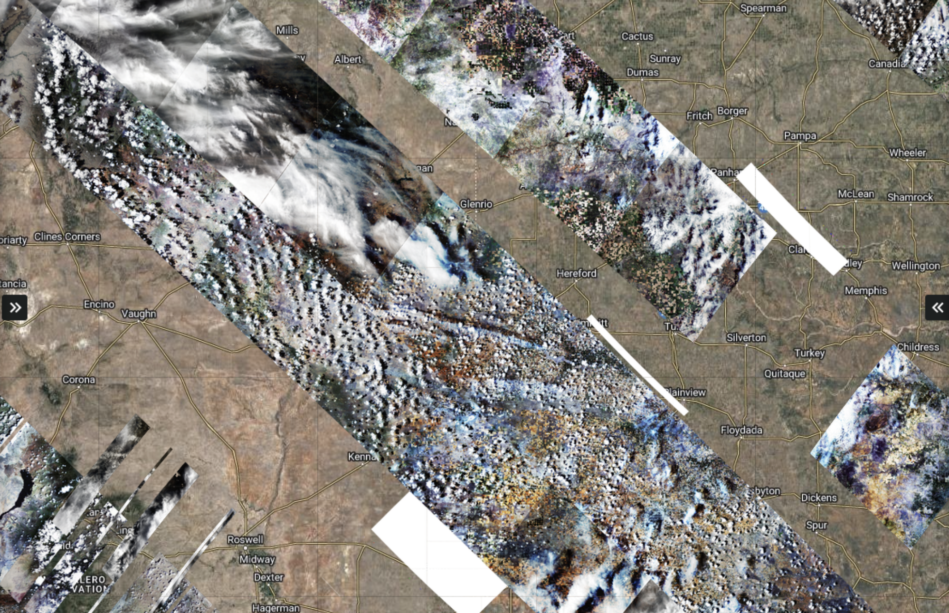
EMIT Mission
Task 2: Objective
Notes:
Explain point of knowing aerosol optical depth accuracy

